Slide 1


Continuous Integration

Slide 2
Continuous Integration
2

Slide 3



Continuous Integration: A Recap
Continuous Integration (CI) is a development practice that requires developers to integrate code into a shared repository several times a day. Each check-in is then verified by an automated build, thereby allowing teams to detect problems early
By integrating code regularly, you can detect errors quickly, and locate them more easily
thoughtworks.com
“Continuous Integration doesn’t get rid of bugs, but it does make them dramatically easier to find and remove”
Martin Fowler
Chief Scientist, ThoughtWorks

Slide 4
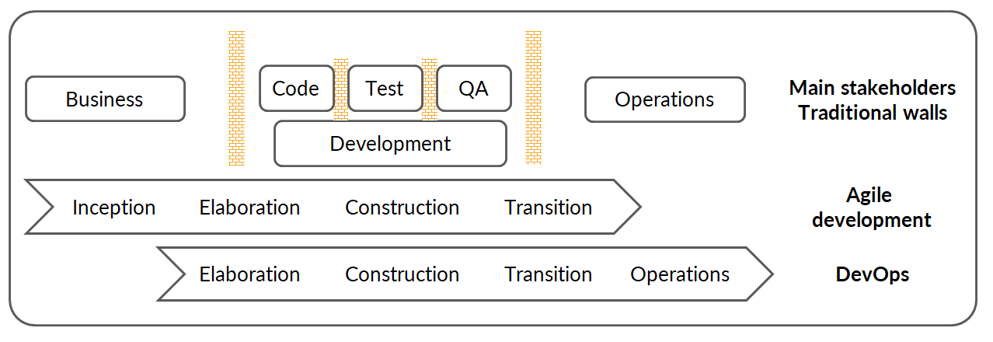
Drawbacks of Traditional SDLC
Agile breaks down the wall between the Business and Development teams
DevOps breaks down the wall between the Development and Operations teams
DevOps centres on the concept of sharing (ideas, issues, processes, tools and goals)

Slide 5


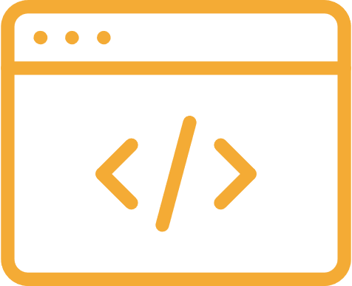
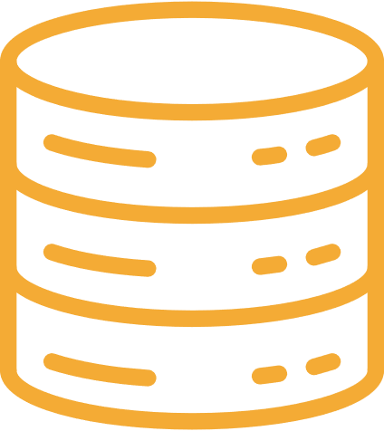

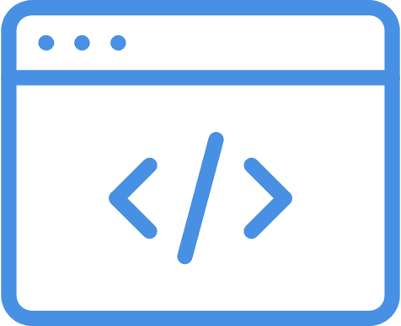
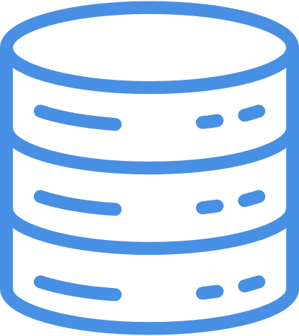
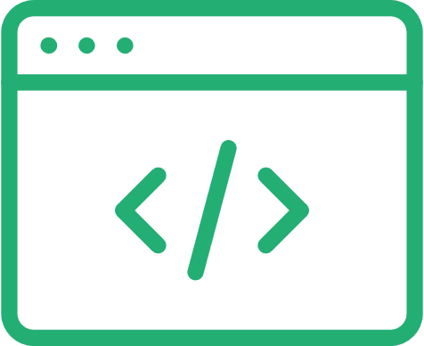
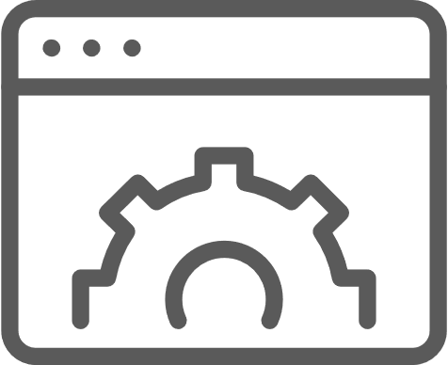
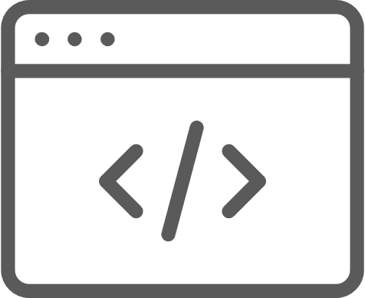
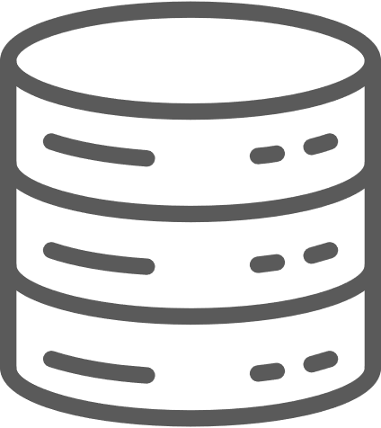
Old School Integration: Before CI was Introduced
Build &
Integration Team
Customer
Profile
Product
Catalog
Integrate
Compile
Package
Order
Tracking

Slide 6
Old School Integration: Pain Points
Issues with software roll-out when Continuous Integration is not used:
(Code) Integration is painful and requires effort
Fixing issues at the end of iterations
Intermediate merge issues can hold up teams
Long feedback cycle for functional defects
Long iterations

Slide 7

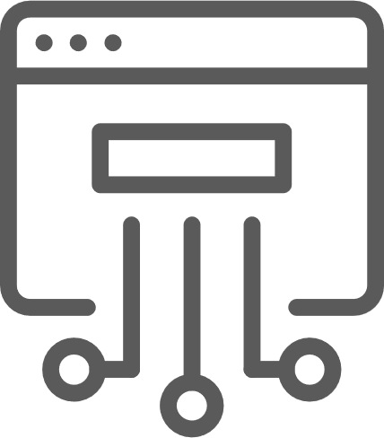

Implementing Continuous Integration
How does Continuous Integration help in fixing the pain points?
Build &
Integration Team
Customer
Profile
Master
Compile
Package
Automated
unit tests
Automated
UI tests
Product
Catalog
Order
Tracking

Slide 8
Benefits of Introducing Continuous Integration
Reduced risk
Increased confidence
Better quality code
Ready-to-ship code
Systematic versioning
Code quality trend analysis
Time taken for marketing
Reduced cost

Slide 9
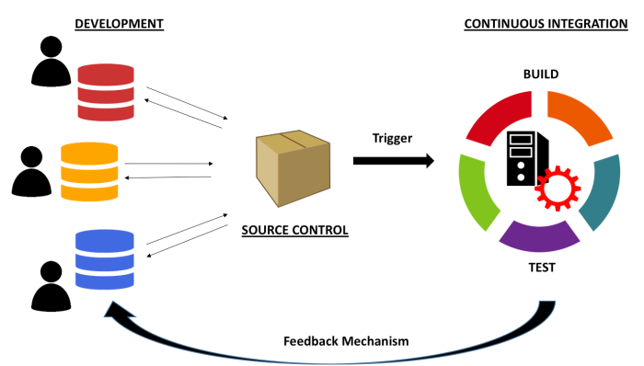
Continuous Integration: Summary

Slide 10
Principles of Continuous Integration
A single central repository where the code is stored.
Developers check in or commit their code frequently
Build should be triggered every time a developer checks in code
Build should be automated and fast
Build should compile the code as well as run automated test suites
Fixing a failed build should be the top priority for developers
Build results should always be communicated to all developers

Slide 11
Continuous Integration Phases
11

Slide 12
Continuous Integration Phases
Unit Testing
Compilation and Packaging
Continuous Testing
Code Review (Static Code Analysis)
Artifact Repository

Slide 13
Unit Testing
What is Unit Testing?
Why do we need to perform unit testing?
Some popular testing tools

Slide 14

What Is Unit Testing?
Unit Testing is a software testing method by which individual units of source code—sets of one or more computer program modules together with associated control data, usage procedures, and operating procedures—are tested to determine whether they are fit for use
Wikipedia

Slide 15
Unit Testing: Why Do It?
Improves the quality of code
Goes hand in hand with Agile processes
Helps to find software bugs early
Helps to understand the design in a better manner
Reduces ‘Technical Debt’
Dzone DevOps Zone

Slide 16
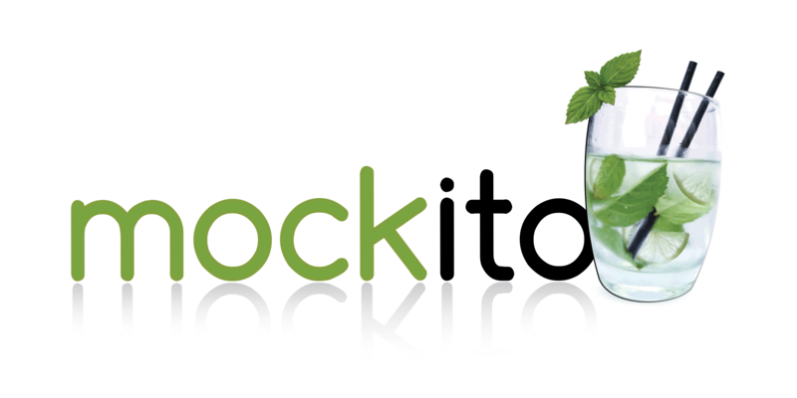
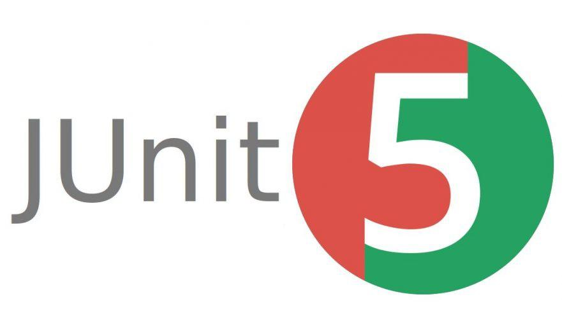

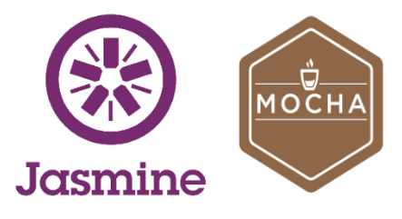

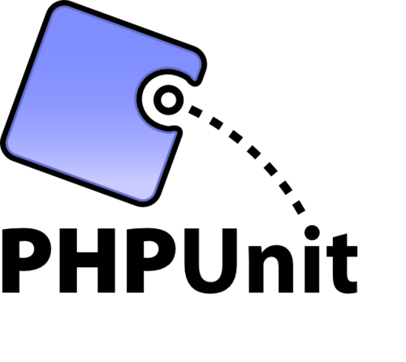
Some Popular Unit Testing Tools

Slide 17
Compilation and Packaging
Automated software builds that can be triggered from the command line are an essential and integral part of any CI pipeline
A modern full-fledged automated build tool should have the following capabilities among others:
Initialising the environment
Compiling source code
Setting up test data
Compiling and running tests
Building Artifact for delivery/deployment
Examples of build tools: Make (C/C++), Rake (Rails), MSBuild and NAnt (.Net) and Ant, Maven, Gradle (Java), etc.

Slide 18



Compilation and Packaging
Flow diagram explaining how compilation and packaging is being run by CI server
Fetch Changes
Code
Checkins
Build Notifications

Slide 19
Static Code Analysis
Definition
Static code analysis (also known as Source Code Analysis) is a method of debugging by examining source code before a program is run. This is done by analysing a set of code against a set (or multiple sets) of coding rules
Some of the common techniques are Taint Analysis and Data flow Analysis
Taint Analysis
Taint analysis is an analysis that detects any injection vulnerability pattern in source code. The analysis identifies the information flow of untrustworthy input that affects the sensitive sink or part of the system
Data Flow Analysis:
Data flow testing is a testing strategy that focuses on the data variables and their values, used in the programming logic of the software product, by making use of the control flow graph. Data flow testing is a form of white box testing and structural type testing that generally keeps check at the points where the data values are being received by the variables and at the points when it is called for use.

Slide 20
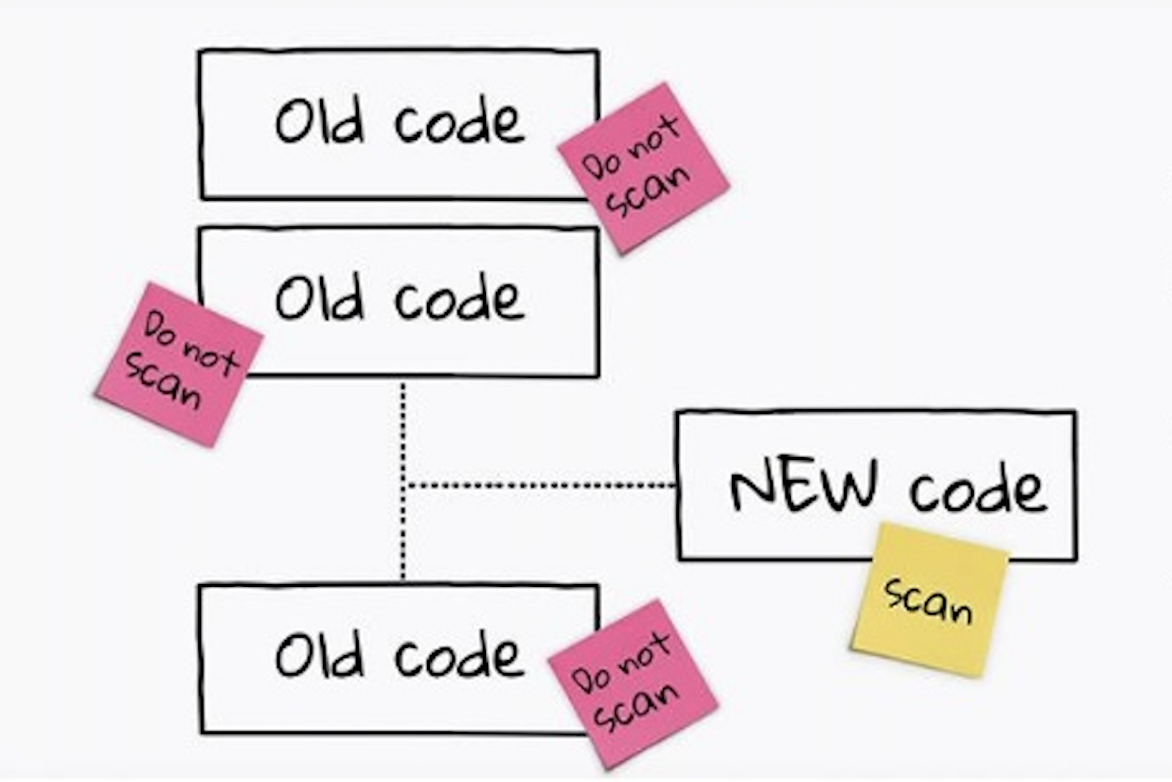
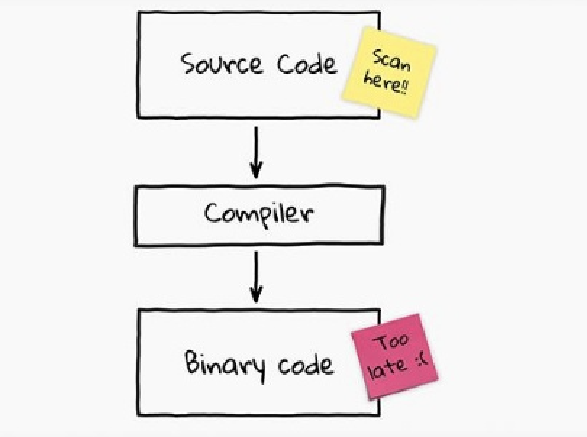
Benefits of Static Code Analysis
Evaluation of full source code, which increases the code quality
Typically done using automated tools, making it less prone to human error
Much faster than other methods of code review mechanisms
More cost-effective than pair programming
Incremental scan capability only analyses new or modified code
No dependencies need to be configured. You just throw at it!

Slide 21
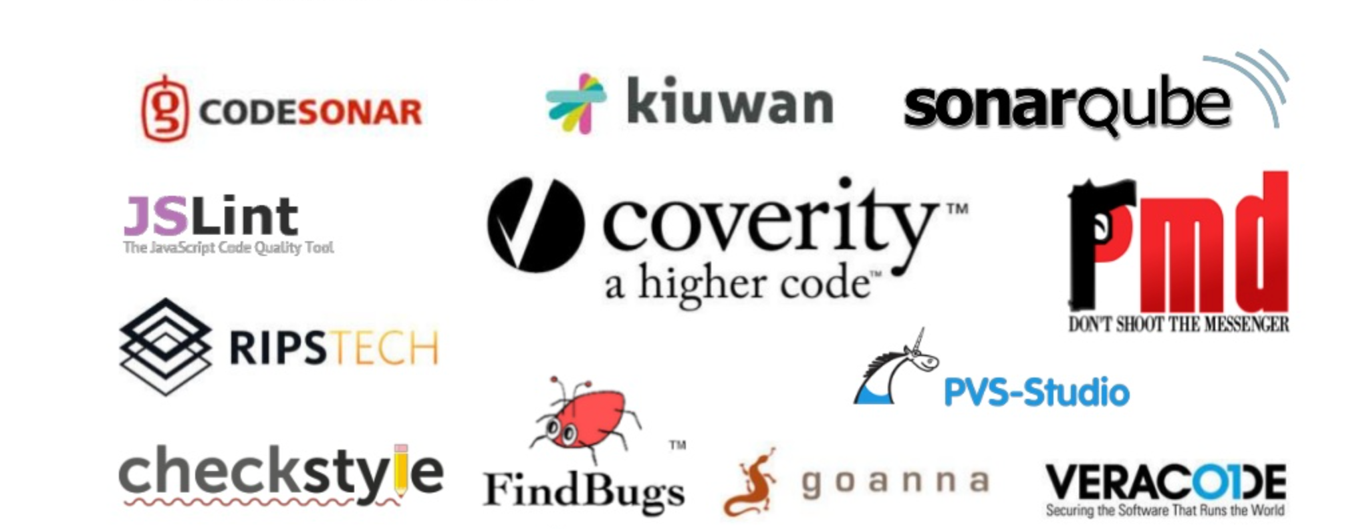
Static Code Analysis: Popular Tools

Slide 22
CI/CD Tools in GCP

Slide 23
CI/CD Tools in GCP
Key Tools:
Cloud Build: Automates build, test, and deployment workflows.
Cloud Source Repositories: Managed Git repositories for seamless source code management.
Artifact Registry: Centralized storage for build artifacts like container images, Maven packages, etc.
How They Work Together:
Cloud Source Repositories stores code.
Cloud Build automates CI/CD pipelines.
Artifact Registry stores and manages build outputs.
Notes:
Key Tools:
Cloud Build: Functions as your CI/CD automation platform, handling everything from building and testing code to deploying your applications. It integrates seamlessly with other Google Cloud services and can automate complex workflows.
Cloud Source Repositories: Provides fully managed Git repositories that are hosted on Google Cloud. It offers secure and private source code management with deep integration into the Google Cloud ecosystem.
Artifact Registry: Serves as your central hub for storing and managing build artifacts. It can handle various types of packages including container images, Maven/Gradle dependencies, npm packages, and other build outputs.
How They Work Together:
Cloud Source Repositories acts as the foundation by hosting your source code in secure Git repositories. Teams can collaborate, manage versions, and trigger automated processes from here.
Cloud Build picks up changes from Cloud Source Repositories and executes your defined CI/CD pipelines. It can automatically build, test, and prepare your applications for deployment based on your specifications.
Artifact Registry stores the outputs from Cloud Build processes, making them available for deployment or further use. These artifacts are version-controlled and easily accessible for your deployment needs.

Slide 24
Introduction to Cloud Build
What is Cloud Build?
Serverless CI/CD platform for automating builds and deployments.
Key Features:
Multi-Environment Support: Works with Docker, Maven, Gradle, and more.
Custom Build Steps: Define workflows using YAML configuration files.
Integration: Compatible with GCP services and third-party tools.
Notes:
"Cloud Build is a fully managed, serverless CI/CD service that eliminates the need for maintaining build servers."
"It supports a wide range of environments, making it versatile for different programming languages and frameworks."
"One of its strengths is the ability to define custom build workflows using simple YAML files, which we’ll explore in the hands-on session."
"It also integrates seamlessly with GCP services like Cloud Run, App Engine, and Kubernetes Engine, enabling end-to-end automation."

Slide 25
Introduction to Cloud Build
What is Cloud Build?
Serverless CI/CD platform for automating builds and deployments.
Key Features:
Multi-Environment Support: Works with Docker, Maven, Gradle, and more.
Custom Build Steps: Define workflows using YAML configuration files.
Integration: Compatible with GCP services and third-party tools.
Notes:
"Cloud Build is a fully managed, serverless CI/CD service that eliminates the need for maintaining build servers."
"It supports a wide range of environments, making it versatile for different programming languages and frameworks."
"One of its strengths is the ability to define custom build workflows using simple YAML files, which we’ll explore in the hands-on session."
"It also integrates seamlessly with GCP services like Cloud Run, App Engine, and Kubernetes Engine, enabling end-to-end automation."

Slide 26
Features of Cloud Build
Core Capabilities:
Automated Builds: Reproducible builds directly from source code.
Testing Code: Run unit tests and integration tests as part of the build process.
Deployment: Automates deployment to App Engine, Kubernetes, and other GCP services.
Benefits:
Increases speed and reliability of development workflows.
Scales to handle large projects with minimal configuration.
Reduces manual effort through automation.
Notes:
"Cloud Build accelerates development by automating repetitive tasks like building and testing code."
"Imagine committing your code to a repository, and within minutes, it’s tested and deployed to your production environment—that’s the power of Cloud Build."
"This level of automation reduces errors, improves consistency, and speeds up delivery cycles."

Slide 27
Hands-On: Configuring Cloud Build Pipeline
Notes:
Steps to Set Up a Pipeline:
Prepare Source Code:
Store code in Cloud Source Repositories or another Git provider.
Create a Build Configuration File:
Use YAML to define build steps and environments.
Trigger Cloud Build:
Use the GCP Console or CLI to start the pipeline.

Slide 28
Artifact Repository
One of the main objective of a fully integrated CI system is to generate the bundled software artifacts with the latest code changes and make it available for Continuous Delivery or Continuous Deployment pipelines
For this purpose, we generally need an Artifact Repository software, which typically acts as an output location for a CI workflow and an input location for a CD workflow
An Artifact Repository is sometimes also referred to as Artifact Management Tools.
Artifact repositories make:
    Dependency management easier
    Releases more stable
    Audit easier and more feasible

Slide 29
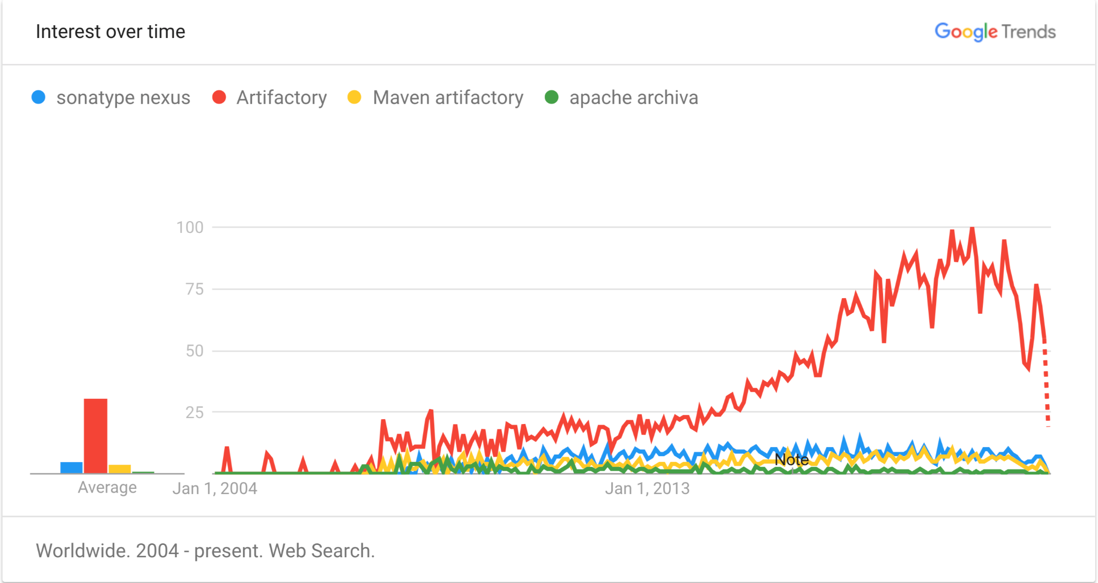
Popular Artifact Repositories
Sonatype Nexus
Jfrog Artifactory
Maven Artifact Repository
Apache Archiva

Slide 30
Hands-On: Setting Up Artifact Registry
Notes:
Steps:
Enable Artifact Registry API:
Use GCP Console or CLI to activate the service.
Create a Repository:
Define repository type (e.g., Docker) and location.
Push Container Images:
Authenticate and use docker push to upload images.

Slide 31
Thank You!

